Slide 1
Chapter 2 NATIONAL INCOME ACCOUNTING

Slide 2
Why do we study national income accounting?
To provide formal structure of our macro-theory models.
To learn statistics that help characterize the economy.
https://www.bea.gov/products/national-income-and-product-accounts

Slide 3
OUTPUT
Production/Supply Side
Wages, Rent, Interests & Dividends
Consumption/Demand side
Consumption, Investment
Provides a framework to study aggregate supply side of the economy.
Provides a framework to study the aggregate demand side of the economy.

Slide 4
Gross Domestic Product (GDP)
Gross domestic product or GDP is the final value of all goods and services produced in the country within a given period of time.
It is the sum of all factor payments.

Slide 5
Key Points to Remember
GDP includes only currently produced goods and services.
It means that it excludes:
Any used items.
Any transaction in which money is transferred without any accompanying good or service in return, such as government transfers.

Slide 6
Key Points to Remember
Includes production within the borders of an economy, regardless whether the production is done by domestic or foreign factors of production.
Example: Japanese cars produced in Kentucky

Slide 7
Key Points to Remember
GDP includes only those currently produced goods and services produced within the borders of an economy which can be sold on the market, i.e.,
The goods and services are valued at market prices.
Excludes things not exchanged on the market such as volunteer work.

Slide 8
Key Points to Remember
GDP includes only those currently produced goods and services produced within the borders of an economy which can be sold on the market during a particular time, but not resold.
Not resold means that it includes only final products. Intermediate goods intended for resale are excluded because that will lead to double-counting.

Slide 9
Which of the following is a final good or service?
- fertilizer purchased by a farm supplier
- a haircut
- Chevrolet windows purchased by a General Motors
assembly plant.

Slide 10

Do the people in a country with a higher level of GDP live better?

Slide 11
Components of GDP
‘C’ includes spending on anything from food to golf lessons. The goods can be durable (automobiles) & non-durable (milk). Has the largest share of GDP.
‘I’ includes additions to the physical stock of capital (i.e. building machinery, construction of factories, additions to firm’s inventories).

Slide 12
‘G’ includes items such as national defense expenditures, costs of road paving by state and local governments and salaries of govt. employees.
Note: Government purchases on goods and services does NOT include transfer payments like social security benefits and unemployment benefits.
Net Exports (NX) is also called the trade surplus. When net exports are negative, we have a trade deficit.

Slide 13
GDP (Y) ≡ Personal consumption expenditures (C)
+ Gross Private Domestic Investment (I)
+ Government Purchases of goods and
services (G) + Net exports (NX), where
Net exports (NX) ≡ Exports (X) – Imports (M)
Fundamental National Income Accounting Identity:
Y ≡ C + I + G + (X – M)

Slide 14
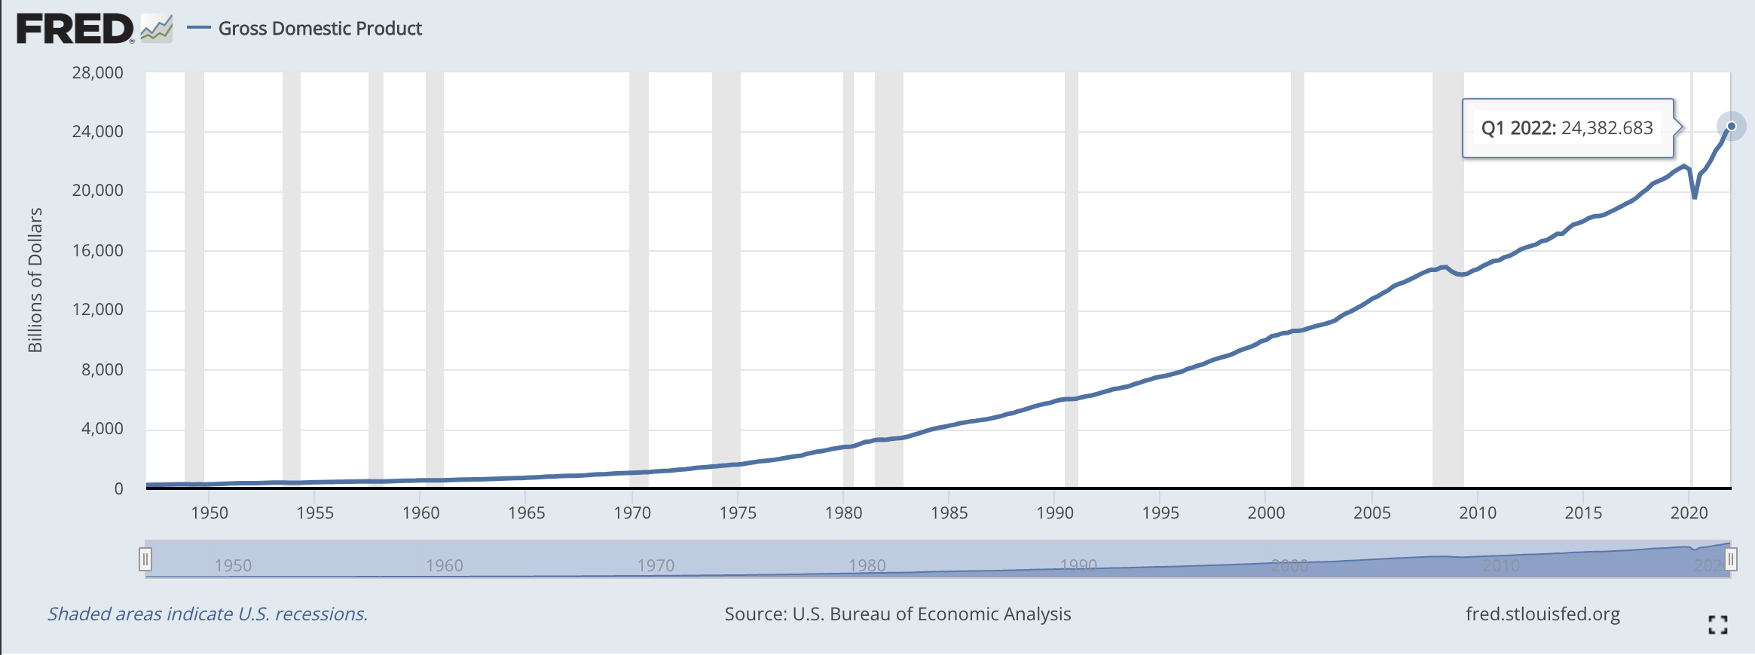
US Nominal GDP

Slide 15
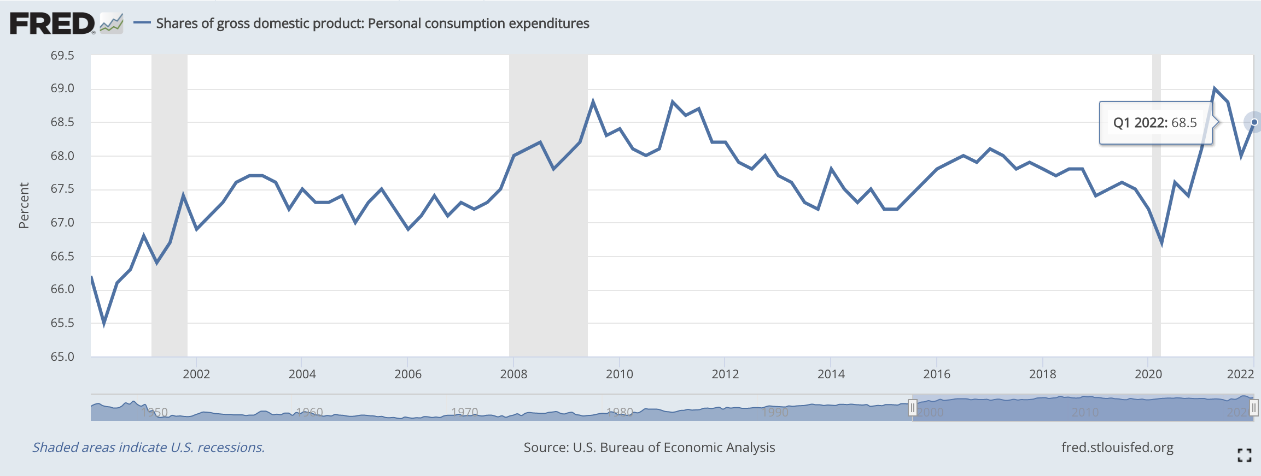
Share of GDP: Personal Consumption Expenditure (C)

Slide 16
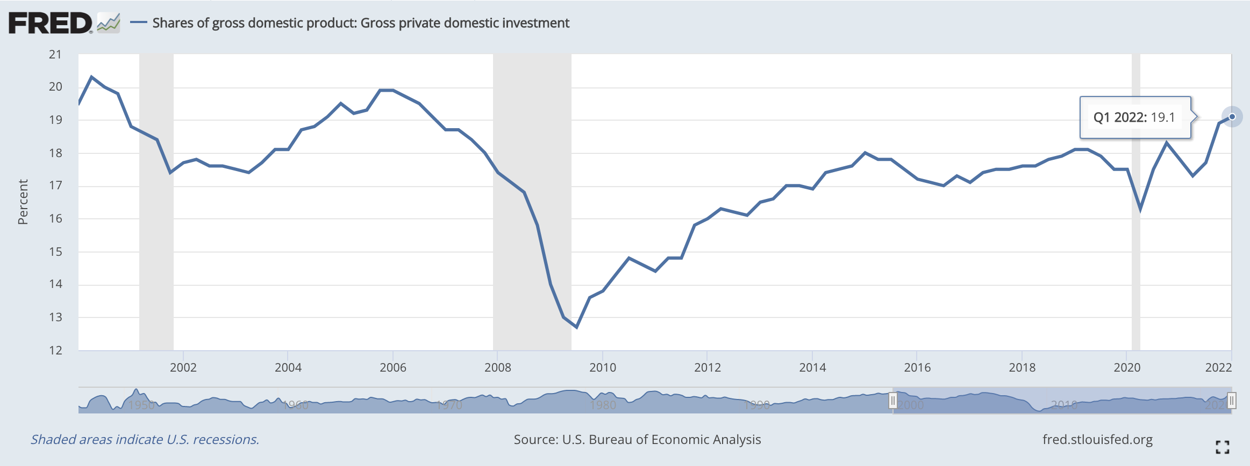
Share of GDP: Gross Domestic Private Investment (I)

Slide 17
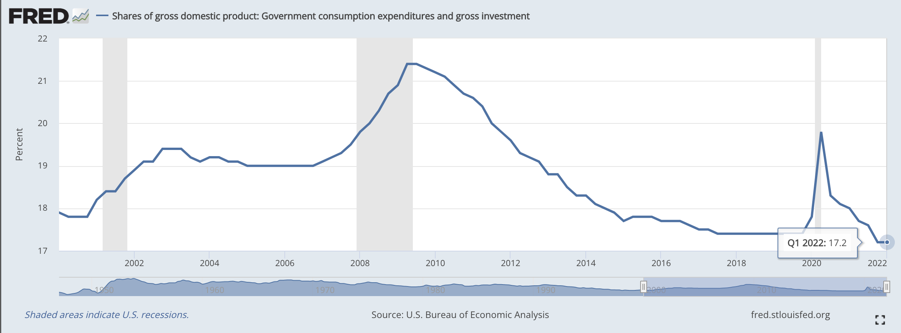
Share of GDP: Government Purchases of Goods & Services (G)

Slide 18
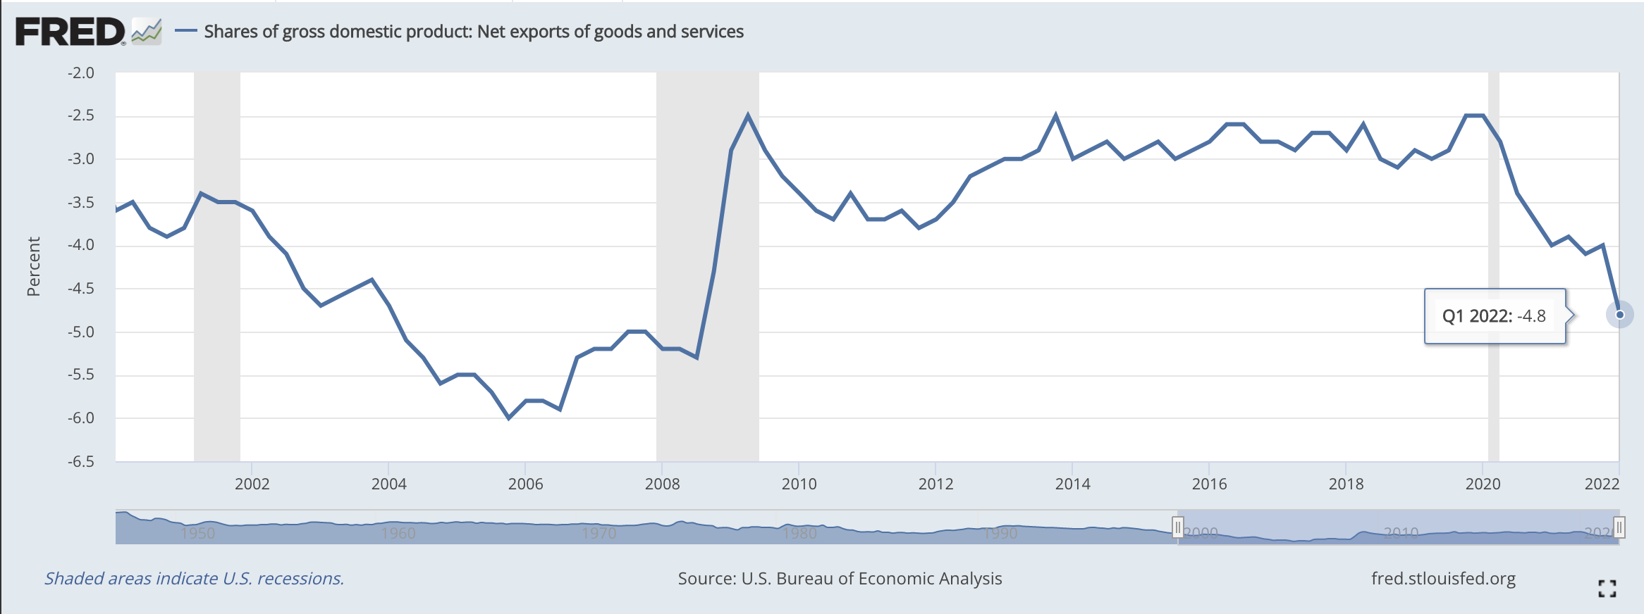
Share of GDP: Net Exports of Goods & Services (NX)

Slide 19
Problems of GDP Measurement
Some outputs are poorly measured because they are not traded in the market.
Some illegal activities and black-market transactions, like drugs are not accounted for.
The accounts do not subtract anything for environmental pollution and degradation.
Difficult to account correctly for improvements in the quality of goods.

Slide 20
Gross National Product (GNP)
An estimate of total value of all the final products and services turned out in a given period by the means of production owned by a country’s residents.

Slide 21
GNP ≡ GDP + Value of production outside
domestic borders attributable to labor
and property owned by domestic
residents - Value of production within
domestic borders attributable to labor &
property owned by foreign residents.

Slide 22
Are the profits earned by Japan’s Honda from its US manufacturing operations a part of Japanese GNP or US GNP? Are these profits a part of US GDP or Japanese GDP?

Slide 23
Nominal vs. real GDP
NGDP is the value of output in a given period measured in current dollars
Changes in NGDP could be purely due to changes in prices → if GDP is to be used as a measure of output, need to control for prices

Slide 24
Nominal vs. real GDP
RGDP is the value of output in constant dollars → scaled by a based year price, so that any change in GDP is due to change in production, not prices.
If P^{B} is the price in the base year for good i, RGDP in 2007 is:
vs.

Slide 25
Nominal vs real GDP
 | 2009 Nominal GDP | 2016 Nominal GDP | 2016 Real GDP*
Beer | 1 at $1.00 $1.00 | 2 at $2.00 $4.00 | 2 at $1.00 $2.00
Skittles | 1 at $0.50 0.50 | 3 at $0.75 2.25 | 3 at $0.50 1.50
 | $1.50 | $6.25 | $3.50
*Measured in 2009 prices.

Slide 26
Real GDP data
Real GDP grows over time
The real GDP of the U.S. economy in 2015 was more than four times its 1965 level
Growth – average 3% per year since 1965
Growth is not steady
GDP growth interrupted by recessions

Slide 27
Real GDP Per Capita
Real GDP divided by Population. This is the "average" output of the economy per person measured in a base year prices.
This ratio is often used as a measure of standard of living in comparisons over time of one country, or between different countries when measured in the same currency.

Slide 28
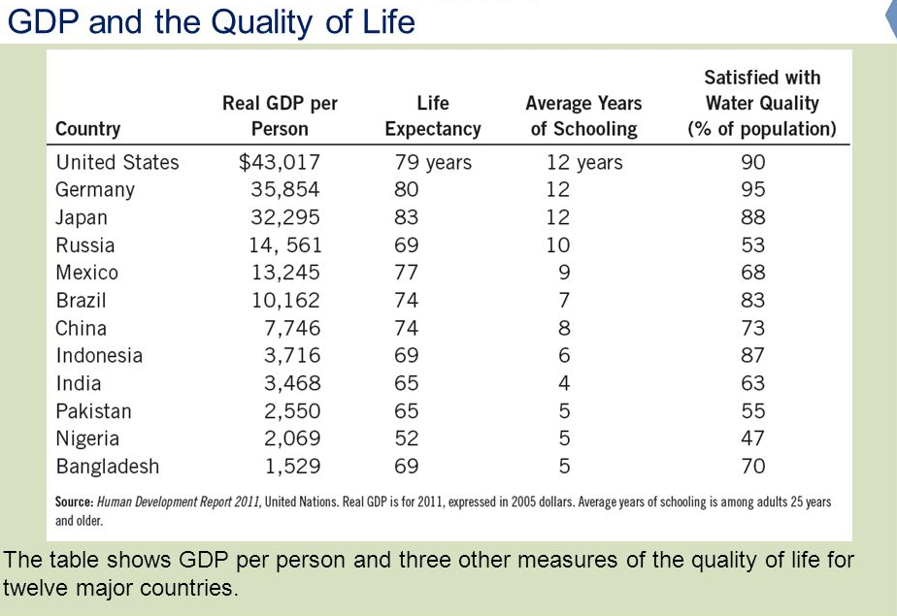

Slide 29

Low GDP per person
More infants with low birth weight
Higher rates of infant mortality
Fewer school-age children are actually in school
Fewer teachers per student
Fewer paved roads
Fewer households with electricity

Slide 30
Personal Disposable Income (Y^{d})
Can be informally referred to as take-home pay.
Y^{d} ≡ PI – Personal Income Taxes
Y^{d} ≡ Y + TR – TA
where Y^{d} is personal disposable income, PI is personal income, TR is government transfers and TA is personal income taxes.

Slide 31
Government Budget Balance
Government Budget Deficit = (G + TR) – TA
Government Budget Surplus = TA – (G + TR)

